Slide 1
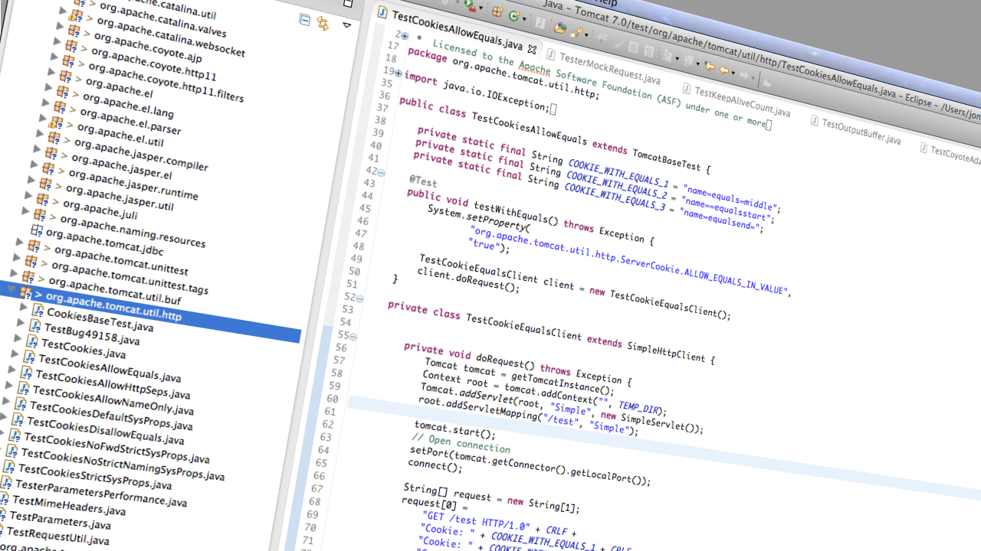
Faster, More Reliable Builds
Jonathan Bell (@_jon_bell_)
Columbia University
Notes:
Good afternoon. My name is Jonathan Bell, and I am a PhD student at Columbia University advised by Gail Kaiser.

Slide 2







Simplified Software Lifecycle
Make changes to code
Build & test
How long is too long of a build?
1 day?
6 hours?
10 minutes?
Commit
Notes:
Let’s start off by taking a step back and looking at the role of testing in a typical, simplified software development lifecycle.
We start off with a developer, who creates or changes some code
Then our developer wants to see if their change was successful - so before doing anything else, they build and test it.
Then finally, they commit their change to a version repository if it was successful. And then, they do it all over again. Of course this process will have some variations, but we are pretty much always looking at this code-build-test-repeat lifecycle.
And my question to you is: how long is too long to wait for a build to complete? We have reports from our industry partners of builds taking days, which clearly is too long. Others report builds taking several hours. These long builds would pose a serious problem for any development methodology: even if builds were only completed nightly it would be a challenge to keep up.
Even in projects with shorter builds, say 10 minutes, this latency is still a bottleneck in a modern continuous integration pipeline. So what exactly are we spending all of this time doing?

Slide 3
Simplified Software Lifecycle
Compile sources
Generate documentation
Run tests
Package
Make changes to code
Build & test
Commit
Notes:
While exact specifics may vary, in Java projects, this build and test phase typically consists of four main components - compiling sources, generating documentation, running tests, and packaging artifacts. While we had anecdotal evidence that testing was the greatest bottleneck in Java builds, we wanted to empirically validate this assumption.
We studied the 351 largest Java projects from github - that were easily build able out-of-the-box with maven - to look at the distribution of time spent on each of these phases

Slide 4
Testing Dominates Build Times
Other
Testing
Compiling
351 projects from GitHub
Notes:
Across all of these projects, testing took on average 41% of the build time - it was by a narrow margin the most dominant phase.

Slide 5
Testing Dominates Build Times
Other
Compiling
Testing
Projects taking > 10 minutes to build (69)
Notes:
Excluding the very short building projects, and looking only at those that took 10 minutes or more to build, testing took the majority of the total build time - on average 60%

Slide 6
Testing Dominates Build Times
Other
Compiling
Testing
Projects taking > 1 hour to build (8)
Notes:
Finally, looking at those projects that were the very slowest, which might benefit the most from some form of build acceleration - those that took an hour or more to build - we found that testing took on average 90% of build time.

Slide 7
Flaky Tests Fail Builds
Errored
Failed (Other)
Failed (Tests)
Passed
8,432 builds of 201 Java Projects on Travis CI
[Beller, Gousios and Zaidman ‘15]
Notes:
With testing taking so much time in the build process, it may come as no surprise that failing tests can break an entire build. In Beller et al’s recent study of builds on the open source continuous integration site, Travis CI, they found that half of all non-passing builds were failed by tests (rather than other components of the build). Moreover, they found that 34% of all Java projects had at least one build where tests behaved inconsistently - showing different results when re-executed, without changing any code.

Slide 8
Faster tests = Faster builds
Reliable tests = Reliable builds
Notes:
So with testing taking so long in the Java build process, it’s clear that accelerating testing and making it more reliable will lead directly to faster, more reliable builds. We want to cut our day long builds to several hours, our hour long builds to minutes, and our ten minute builds to just several minutes, and greatly reduce the latency that developers suffer to get that feedback about whether their change was successful.

Slide 9


Test Suite Minimization
Test 1
Test 2
Test 3
Test 4
Test 5
Test 6
Test 7
< /> Code
Test 8
Test 9
Test 10
Test 11
Test 12
Test 13
Test 14
Redundant tests: removed
Hao et al. [ICSE ’12]; Orso et al. [ICSE ’09]; Jeffrey et al. [TSE ’07]; Tallam et al. [PASTE ’05]; Jones et al. [TOSEM ’03]; Harrold et al. [TOSEM ’93]; Chen et al. [IST ’98]; Wong et al. [ICSE ’95] and more
Notes:
There are several previous, well-studied approaches to accelerating testing, for instance, Test suite minimization

Slide 10

Regression Test Selection
Test 1
Test 2
Test 3
Test 4
Test 5
Test 6
Test 7
Changeset
Test 8
Test 9
Test 10
Test 11
Test 12
Test 13
Test 14
Tests not relevant to changeset: skipped
Gligoric et al. [ISSTA ’15], Orso et al. [FSE ’04], Harrold et al. [OOPSLA ’01]
Notes:
Alternatively, developers may turn to test suite selection

Slide 11

JUnit Test Execution
Overhead of restarting the JVM?
Start JVM
Terminate App
Start Test Suite
Begin Test
Unit tests as fast as 3-5 ms
Execute Test
JVM startup time is fairly constant (1.4 sec)
Up to 4,153%, avg 618%
1.4 sec (combined)
For EVERY test!
*From our study of 20 popular FOSS apps
Notes:
Our goal, however, is to accelerate testing overall - independently of techniques that select tests to run. So we took a look at the overall test execution process commonly used in Java builds.

Slide 12
Do applications really use a new JVM for each test?
Checked out the 1,000 largest Java projects from Ohloh
81% of projects with more than 1,000 tests do it
71% of projects with more than 1 million LOC do it
Overall: 41% of all of the projects do
Notes:
To underscore that this factor contributes to the testing time of real-world applications, we checked out…
… Our approach addresses the same problem that forces these developers to use a new JVM for each test case, but with much lower overhead.

Slide 13
Test Independence
We typically assume that tests are order-independent
Might rely on developers to completely reset the system under test between tests
Who tests the tests?
Dangerous: If wrong, can have false positives or false negatives (Muşlu [FSE ’11], Zhang [ISSTA ’14])
Notes:
Why do developers pay this high price to isolate their tests? The answer, is test independence

Slide 14

Test Independence
This field is set once, when the class that owns it is initialized
/** If true, cookie values are allowed to contain an equals character without being quoted. */
public static boolean ALLOW_EQUALS_IN_VALUE =
Boolean.valueOf(System.getProperty("org.apache.tomcat.
util.http.ServerCookie.ALLOW_EQUALS_IN_VALUE","false"))
.booleanValue();
This field’s value is dependent on an external property
Notes:
So, how can tests become dependent on each other?

Slide 15

A Tale of Two Tests
public static boolean ALLOW_EQUALS_IN_VALUE = Boolean.valueOf(
System.getProperty(“org.apache.tomcat.util.http.ServerCookie.
ALLOW_EQUALS_IN_VALUE","false")).booleanValue();
TestAllowEqualsInValue
TestAllowEqualsInValue
TestDontAllowEqualsInValue
TestDontAllowEqualsInValue
Sets environmental variable to true
Start Tomcat, run test
Sets environmental variable to false
Start Tomcat, run test
But our static field is stuck!

Slide 16
Hypothesis:
The testing process will be made faster and more stable my modifying testing tools to detect otherwise hidden state dependencies.

Slide 17



Smarter Test Isolation for Faster Testing
“Unit Test Virtualization with VMVM”
[Bell and Kaiser at ICSE ’14; Distinguished Paper Award]

Slide 18
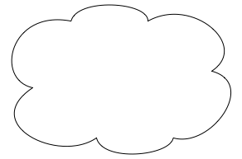
How do Tests Leak Data?
Java is memory-managed, and object oriented
We think in terms of object graphs
Test Runner Instance
references
references
references
Test Case 1
Test Case 2
Test Case n
references
references
references
Accessible
Objects
Accessible
Objects
Accessible
Objects
No cross-talk
No cross-talk
Notes:
To explain how we implement unit test virtualization, let’s first discuss briefly how exactly tests can leak data.

Slide 19
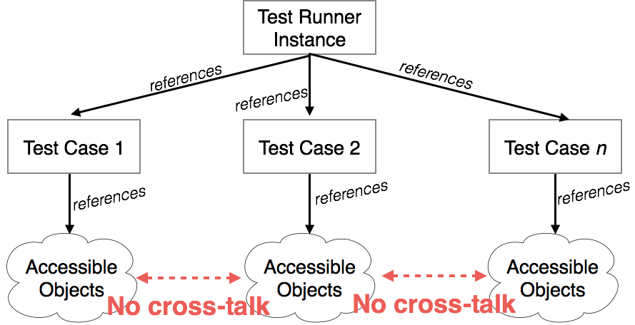
How do Tests Leak Data?
Java is memory-managed, and object oriented
We think in terms of object graphs

Slide 20
How do Tests Leak Data?
Java is memory-managed, and object oriented
We think in terms of object graphs
Class A
Class B
Static fields: owned by a class, NOT by an instance
Static
Fields
Static
Fields
These are leakage points
references
references
Notes:
The object graph tells us what instances we hold references to, but that is not the complete picture - code can reference to “static fields” by knowing only the name of the class to which the field belongs, no need for a reference to a specific instance of that class. These are our leakage points that must be protected.

Slide 21
Isolating Side Effects
Class A
Class B
Class C
Static
Fields
Static
Fields
Static
Fields
Static
Fields
Writes
Reads
Writes
Reads
Test 1
Test 2
Notes:
Let’s look at a simple execution and see how these side effects might occur.

Slide 22

Isolating Side Effects
Class A
Class B
Class C
Key Insight:
No need to re-initialize the entire application in order to isolate tests
Static
Fields
Static
Fields
Static
Fields
Static
Fields
*Interception*
Writes
Reads
Writes
Reads
These classes had no possible conflicts
Test 1
Test 2
So, don’t touch them!

Slide 23
VMVM: Unit Test Virtualization
Isolates in-memory side effects, just like restarting JVM
Integrates easily with ant, maven, junit
Implemented completely with application byte code instrumentation
No changes to JVM, no access to source code required
Notes:
We implemented unit test virtualization for java, creating VMVM, named for its mechanism of creating a VM like container within the JVM.

Slide 24
Efficient Reinitialization
Emulate exactly what happens when a class is initialized the first time
First new instance or static reference of T per test
First new instance or static reference of T
Release lock on T
Acquire lock on T
Acquire lock on T
Not initialized
Re-initialize T’s super classes
Initialize T’s super classes
Mark init done
Check initialization status
Run initializer for T
Re-initialize T
Release lock on T
Notes:
Recall that our goal is to isolate static fields, so each test that reads a field will see it “fresh”, and that static fields are initialized when a class is first initialized, so VMVM reinitializes those fields by reinitializing the classes that they belong to.

Slide 25
Efficient Reinitialization
Does not require any modifications to the JVM and runs on commodity JVMs
The JVM calls a special method, <clinit> to initialize a class
We do the same, entirely in Java
Add guards to trigger this process
Register a hook with test runner to tell us when a new test starts
Notes:
Recall however, that I mentioned that we do not require modifications to the JVM, so how do we trigger this internal process?

Slide 26
VMVM: Unit Test Virtualization
if(CookiesSupport.ALLOW_EQUALS_IN_VALUE)
//...
else
//...
if(ShouldReInit(CookiesSupport.class)
CookiesSupport.REINIT();
if(CookiesSupport.ALLOW_EQUALS_IN_VALUE)
//...
else
//...
VMVM adds guards to reinitialize classes

Slide 27
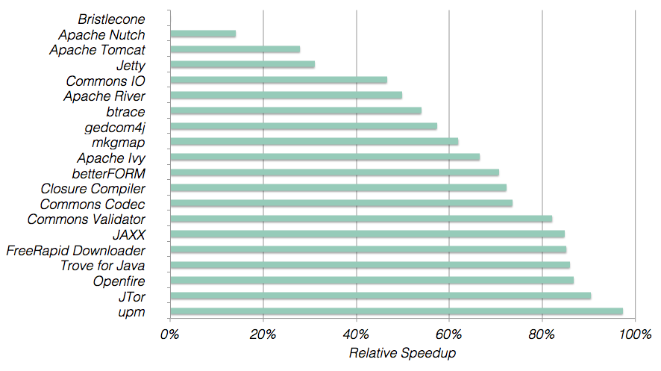
Performance Evaluation
Average: 62%
Max: 97%
Larger is better
Notes:
We show here the relative speedup afforded by VMVM in comparison to a “traditionally isolated” test suite execution, with each test running in the same JVM.

Slide 28
Factors that impact reduction
Looked for relationships between number of tests, lines of code, age of project, total testing time, time per test, and VMVM’s speedup
Result: Only average time per test is correlated with VMVM’s speedup (in fact, quite strongly; p < 0.0001)

Slide 29
Feedback from Developers about VMVM
“It’s great! It cuts our 45 minute tests in half!”
“It’s useless! We don’t isolate our tests! Our tests take 24 hours so isolating them would make them take days!”
Remember: Although our study showed many isolate their tests, not all do!

Slide 30

How do we make it faster?
Unit Tests
VMVM
Java

Slide 31

How do we make it faster?
Unit Tests
VMVM
Java

Slide 32
Testing is Embarrassingly Parallel
Project | Raw time (minutes) | 8 Worker Speedup | 24 Worker Speedup
Internal CI | 20.50 | 2.5x | 1.8x
Mule ESB | 150.92 | 6.4x | 10.9x
Jenkins | 2.33 | 2.2x | 2.3x
OpenWebBeans | 0.54 | 1.9x | 2.1x
Cut from 2.5 hours to 14 minutes

Slide 33
What happens if you don’t isolate?
Notes:
Now you might say, Jon, isn’t test acceleration well studied? And it is - there are many available tools and techniques to accelerate testing - but in practice, there can be complications applying them.

Slide 34
Regression Test Selection
Test 1
Test 2
Test 3
Test 4
Test 5
Test 6
Test 7
Changeset
Test 8
Test 9
Test 10
Test 11
Test 12
Test 13
Test 14
Tests not relevant to changeset: skipped
Gligoric et al. [ISSTA ’15], Orso et al. [FSE ’04], Harrold et al. [OOPSLA ’01]
Notes:
For instance, one tool that developers might use is regression test selection.

Slide 35
Test Suite Minimization
Test 1
Test 2
Test 3
Test 4
Test 5
Test 6
Test 7
< /> Code
Test 8
Test 9
Test 10
Test 11
Test 12
Test 13
Test 14
Redundant tests: removed
Hao et al. [ICSE ’12]; Orso et al. [ICSE ’09]; Jeffrey et al. [TSE ’07]; Tallam et al. [PASTE ’05]; Jones et al. [TOSEM ’03]; Harrold et al. [TOSEM ’93]; Chen et al. [IST ’98]; Wong et al. [ICSE ’95] and more

Slide 36
Test Parallelization
Test 1
Test 2
Test 3
Test 4
Test 5
Test 6
Test 7
Test 8
Test 9
Test 10
Test 11
Test 12
Test 13
Test 14

Slide 37
Test Parallelization
Test 1
Test 2
Test 3
Test 4
Test 5
Test 6
Test 7
Test 8
Test 9
Test 10
Test 11
Test 12
Test 13
Test 14

Slide 38


Controlled Regression Testing Assumption
External Factors
External Factors
External Factors
External Factors
Tests
Test 1
</> Code
Test 2
Test 3
External Factors
External Factors
External Factors
External Factors
Notes:
Our concern about soundly applying these techniques in practice is their reliance on the Controlled Regression Testing Assumption, which essentially says that the only thing that might cause the outcome of a test to change is a change in the program code. That is, all external influences are kept constant, as we run each test, nothing can impact the outcome of that individual test, other than a change in the code.

Slide 39

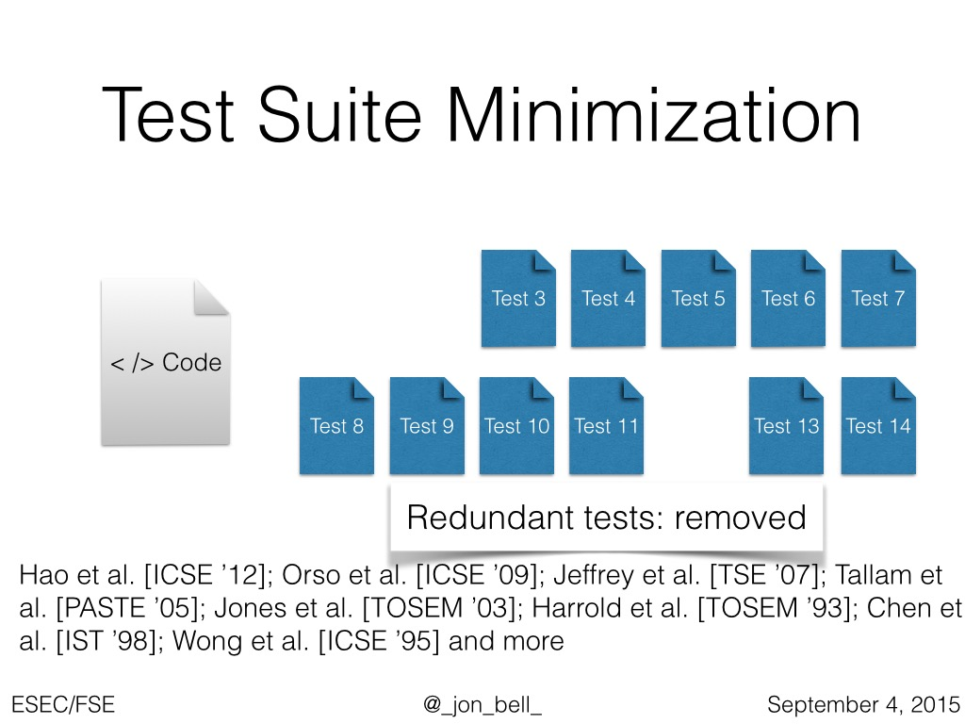
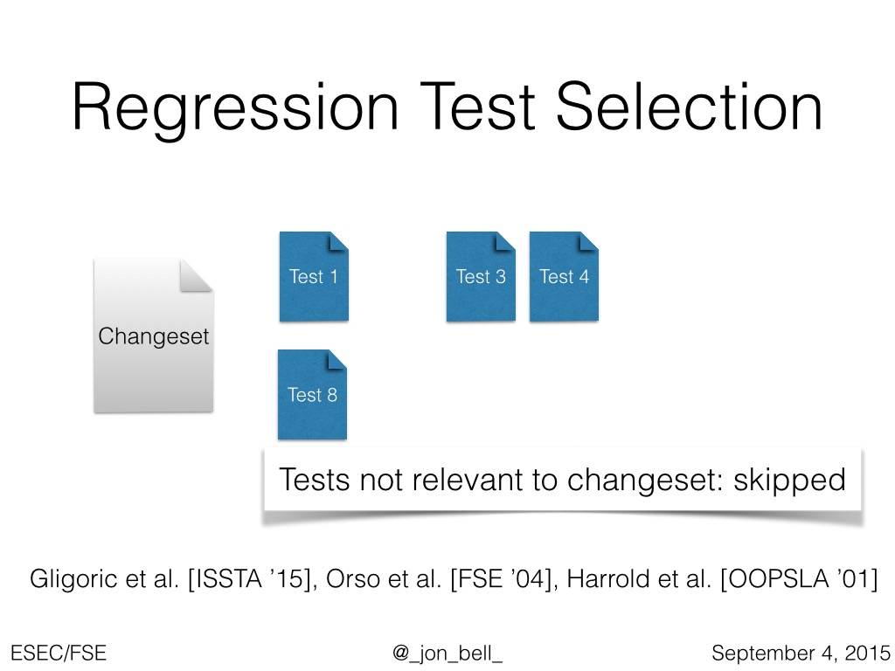
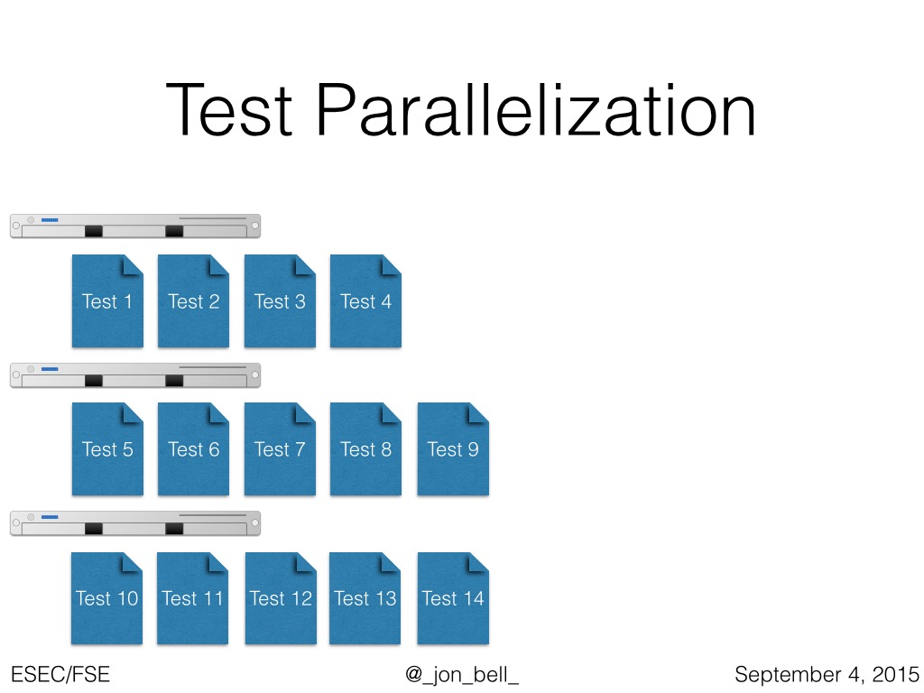
Not sound in practice.
Lead to unreliable builds.
Notes:
So, for these popular test acceleration techniques, we and others have observed that they are often not sound in practice, because these environmental assumptions can’t be enforced. Some of these factors might be straightforward, such as dependence on external systems, or nondeterminism in code. But others are not as straightforward: Note that every single one of these approaches involve removing or reordering tests. This makes them all especially prone to influences from test dependencies — instances where the result of one test might depend on a previous test having run.

Slide 40
Test Dependencies
Test 1
Test 1
Test 2
Test 2
Test 3
Test 3
Test 4
Test 4
Read
Read
Write, Value “B”
Write, Value “A”
Shared File
Value: B
Value: A
Notes:
In this work, we address specifically this problem of test dependencies.

Slide 41


Test Dependencies
Test 1
Test 1
Test 4
Test 4
Test 2
Test 2
Test 3
Test 3
A manifest test dependency
Write, Value “B”
Read
Write, Value “A”
Shared File
Read, Expect Value “A”
Value: B
Value: A
Notes:
Because there is a dependency between the tests, we might have a different outcome if we reorder them.

Slide 42
Test Dependencies:
A Clear and Present Danger
Really exist in practice (Zhang et al. found 96, Luo et al. found 14), lead to flaky tests
Hard to specify - if we could specify, would be safe to accelerate
Can’t arbitrarily isolate (and it adds overhead!)
Existing technique to detect: combinatorially run tests [Zhang, et al ’14]
Notes:
Test dependencies are a clear and present danger to typical test acceleration techniques.
Recent retrospective surveys that studied issue reports have found over a hundred such dependent tests across a handful of projects. These studies reviewed bugs identified by each project’s developers - some taking a sizable amount of time to be resolved — up to 3 years in one case.
But these dependencies are very hard to specify and detect - but if we could specify them, it would indeed be safe to apply our test acceleration techniques to those projects.

Slide 43
Brute Force Dependency Detection
Test 1
Test 1
Test 2
Test 2
Test 3
Test 3
Test 4
Test 4
Notes:
Let’s talk for a moment about the previous approach for detecting test order dependencies: the “brute force” approach. To find all possible dependencies, it runs every possible permutation of tests.

Slide 44
Brute Force Dependency Detection
Test 1
Test 1
Test 2
Test 2
Test 4
Test 4
Test 3
Test 3

Slide 45
Brute Force Dependency Detection
Test 2
Test 2
Test 1
Test 1
Test 3
Test 3
Test 4
Test 4

Slide 46
Brute Force Dependency Detection
Test 4
Test 4
Test 2
Test 2
Test 3
Test 3
Test 1
Test 1

Slide 47
Brute Force Dependency Detection
Test 1
Test 1
Test 3
Test 3
Test 2
Test 2
Test 4
Test 4
Notes:
And so on. But this was only a small number of the combinations that we’d need to run. We considered the feasibility of running this technique on 10 moderately sized open source test suites. Exhaustive approach: > 10^300 years to find all dependencies
Pairwise approach: Average 31,882 executions of the entire test suite to find (incomplete) dependencies

Slide 48
Brute Force Dependency Detection
Looked at feasibility on 10 large open source test suites
Exhaustive approach: > 10³⁰⁰ years to find all dependencies
Pairwise approach: Average 31,882 executions of the entire test suite to find (incomplete) dependencies
Problem: How do we safely accelerate test suites in the presence of unknown dependencies?
Notes:
We looked at the feasibility of this approach on 10 large OSS’s test suites

Slide 49
Manifest Test Dependencies
Definition: a data dependence between tests T1, T2 that results in the outcome of T2 changing
All manifest dependencies are data dependencies
Not all data dependencies are manifest dependencies
Notes:
Before continuing, let’s clarify some terminology.

Slide 50

Data Dependencies
Present Dependencies:
Test 1 must run before 2 and 3
Test 4 must run after 2 and 3
Test 1
Test 1
Test 2
Test 2
Test 3
Test 3
Test 4
Test 4
Read
Read
Write, Value “B”
Write, Value “A”
Shared File
Notes:
So rather than search for manifest test dependencies we could search instead for simple read-over-write and write-over-read data dependencies. Consider again this simple example: if we monitor shared data, we can detect that Test 1 must run before 2 and 3, and 4 must run after 2 and 3. Note that all manifest test dependencies will be caused by a data dependency but not all data dependencies are guaranteed to be manifest test dependencies.

Slide 51
Key Insight: Dependencies don’t need to be precise, but must be sound
Notes:
Our key insight is that we don’t need to be precise in detecting dependencies: if we can relatively quickly find all of the dependencies between tests, it’s OK if we report some dependencies that are NOT truly manifest dependencies.

Slide 52
Intuition
Test 1
Test 2
Test 3
Test 4
Test 1
Test 2
Test 3
Test 4
Test 5
Test 5
Test 6
Test 6
Test 7
Test 7
Test 9
Test 10
Test 10
Test 11
Test 11
Test 14
Test 8
Test 14
Test 8
Test 9
Test 12
Test 12
Test 13
Test 13
Test 15
Test 15
Idle extra capacity
Notes:
The intuition behind our insight is simple. Imagine we we have a lot of tests to run, and we run them in serial order. We might have a lot of extra CPUs idling that could be running tests in parallel, but can’t be used because we don’t know what tests depend on each other.

Slide 53

Intuition
Test 1
Test 2
Test 3
Test 3
Test 8
Test 9
Test 9
Test 10
Test 1
Test 2
Test 8
Test 10
Test 15
Test 15
Test 4
Test 6
Test 7
Test 11
Test 4
Test 5
Test 5
Test 6
Test 7
Test 11
Test 12
Test 12
Test 13
Test 13
Test 14
Test 14
A lot of dependencies, but still a 2x speedup
Idle extra capacity
Notes:
But if we have some information on dependencies, we can now being to safely accelerate the tests. For instance, in this case, perhaps some of the reported dependencies are not indicative of true manifest dependencies. But there is still a 2x speedup - and the previous approach for detecting dependencies would not have been feasible at all, so we could not have safely achieved ANY parallelism before.

Slide 54




Efficient Dependency Detection for Safe Java Test Acceleration
Jonathan Bell, Gail Kaiser, Eric Melski and Mohan Dattatreya
Columbia University & Electric Cloud, Inc
[At FSE ’15]

Slide 55
ElectricTest - Detecting Data Dependencies in Java
Tracks in-memory dependencies (JVMTI plugin)
Tracks file and network dependencies (IO-Trace agent)
Implemented entirely within the Oracle or OpenJDK JVM, no specialized drivers, etc required
Captures stack traces when dependencies occur to support debugging
Generates dependency trees to enable sound test acceleration
Notes:
So we built ElectricTest, a tool that detects data dependencies between tests running in the JVM.
It consists of a JVM tooling interface plugin for tracking in-memory dependencies between tests,
and an IO-Trace based JVM agent for tracking file and network dependencies.
It is implemented entirely within the JVM, requiring no specialized JVM , drivers, and so on.
As it detects data dependencies, it captures stack traces to assist debugging
It also generates dependency trees to enable automatic and sound test acceleration

Slide 56
Identifying Heap Dependencies
After each test, garbage collect; traverse heap to map objects back to static fields.
Class A
static field
static field
static field
static field
W1
W1
W1
W1
End of test 1
W1
W1
W1
W1
W1
Notes:
ElectricTest’s key technical contribution is its technique for detecting in-memory dependencies. ElectricTest tracks the reachability of all variables on the heap from the different heap roots (for our purposes, static fields).
At the end of each test - in this case, the first test, a garbage collection is forced to ensure that the only objects left are those that will be reachable in the next test, and then ElectricTest traverses the heap to map variables back to the static field that points to them. In this process, ElectricTest annotates each (unannotated) variable with a generational counter to indicate that it was written in the just-finished test.
By knowing which heap root or roots point to each variable, we can make debugging and analysis of dependencies much simpler.

Slide 57

Identifying Heap Dependencies
During test execution, monitor accesses to existing objects
Class A
static field
static field
static field
static field
W1
Write!
W2
W1
During Test 2
W1
W1
W1
Dependency!
W1
Write!
W2
Read!
W1
W1
W1
W1
Notes:
When the next test is running, ElectricTest monitors all accesses to the existing objects that had been previously tagged.
This fine grained tracking allows ElectricTest to precisely report dependencies at the object-level, reporting no false positives for data dependencies.

Slide 58

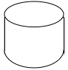
Identifying External Dependencies
Log remote host address
Application under test
Network
Log path
Filesystem
Notes:
To identify external dependencies, say, on the network or filesystem, ElectricTest uses Java’s built-in IOTrace mechanism to intercept all such accesses and log them. Two tests that access the same network host or file are considered data-dependent.

Slide 59
ElectricTest enables sound exploitation of existing test acceleration techniques

Slide 60
Safe Test Parallelization
Test 1
Test 2
Test 3
Test 4
Test 1
Test 2
Test 3
Test 4
Test 5
Test 5
Test 6
Test 6
Test 7
Test 7
Test 9
Test 10
Test 10
Test 11
Test 11
Test 14
Test 8
Test 14
Test 8
Test 9
Test 12
Test 12
Test 13
Test 13
Test 15
Test 15
Notes:
The simplest thing that ElectricTest can do with dependency information is enable safe test parallelization, by automatically grouping tests together by dependencies, allowing for sound parallelization.

Slide 61
Safe Test Parallelization
Test 1
Test 2
Test 3
Test 3
Test 8
Test 9
Test 9
Test 10
Test 1
Test 2
Test 8
Test 10
Test 15
Test 15
Test 4
Test 6
Test 7
Test 4
Test 5
Test 5
Test 6
Test 7
Test 14
Test 14
Test 11
Test 11
Test 12
Test 12
Test 13
Test 13
Notes:
Hence enabling a sound speedup of the test suite.

Slide 62

Safe Test Selection
Test 15
Single test selected to be executed
Notes:
Similarly, this dependency information could be used to enable sound test selection or prioritization - for each test that is selected to be executed

Slide 63
Safe Test Selection
Test 1
Test 2
Test 3
Test 15
Single test selected to be executed with its dependencies
Notes:
ElectricTest would provide the dependencies of that test, ensuring that they were satisfied

Slide 64
Evaluation
RQ1: Recall (accuracy)
RQ2: Runtime overhead
RQ3: Impact on acceleration
Notes:
We evaluated ElectricTest over 3 dimensions: recall (accuracy), runtime overhead, and impact on acceleration techniques

Slide 65
Performance Evaluation
Selected 10 projects with > 10 minutes of tests
Also included projects studied by Zhang et al, averaging < 10 seconds of testing
Previous exhaustive approach slowdown: >10³⁰⁰X
Previous heuristic approach slowdown: 31,882X
ElectricTest slowdown: 36X (885X faster than previous approach)
Notes:
We evaluated the overhead of ElectricTest on 10 projects from our corpus of 351 projects used in our motivating experiments, selecting the longest building projects, with testing times ranging from 2 hours to 17 minutes. We also included the four projects studied by Zhang et al in their evaluation of DTDetector, the previous approach for detecting test dependencies.
To highlight the results, the previous exhaustive approach imposed a theoretical slowdown of more than 10 to the 308th times.
The previous heuristic based approach (which is not guaranteed to detect all dependencies) showed a calculated slowdown of over 2,000 times.
ElectricTest showed a slowdown of only 36 times.

Slide 66
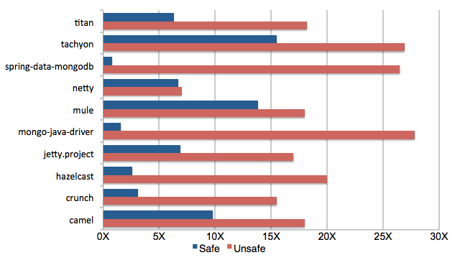
Performance Evaluation
Average (Safe) 7x
Average (Unsafe) 19x
Speedup (higher is better)
Notes:
So ElectricTest is clearly far more feasible to use than the previous brute force approach for detecting dependencies. But does ElectricTest report so many dependencies that it’s impossible to parallelize tests?
We simulated the parallelization of our ten test suites across a 32 core machine. In the unsafe configuration (which is purely a strawman, a hypothetical maximum), we ignored all dependencies and simply distributed tests in a round-robin manner. In the safe configuration, we made sure that all dependencies were respected. On average, the safe configuration allowed for a 7x speedup and the unsafe a 19x - so there is still a relatively reasonable amount of acceleration possible, even with the number of dependencies reported by ElectricTest

Slide 67

Key Insight: Dependencies don’t need to be precise, but must be sound
Why not have both?
Notes:
Our key insight is that we don’t need to be precise in detecting dependencies: if we can relatively quickly find all of the dependencies between tests, it’s OK if we report some dependencies that are NOT truly manifest dependencies.

Slide 68
Precisely Detecting Manifest Dependencies Between Tests
Jonathan Bell, Alex Gyori, Darko Marinov and Gail Kaiser
Columbia University & UIUC
[Proposed work-in-progress]

Slide 69



Sample Data Dependencies
int x = readSharedData();
assertEquals(6,x);
int x = readSharedData();
if(x == 6)
failTest();
getSharedLogger().logVerbose(“Log Ran”);

Slide 70

Dependencies that Matter
Formally: data that’s read AND effects the outcome of the test

Slide 71

Taint Tracking in Testing
Output that is derived
from tainted input
Application
Assertions
Inputs
Data dependency
marked as tainted

Slide 72

Phosphor: Illuminating Dynamic Data Flow in Commodity JVMs
Jonathan Bell and Gail Kaiser
Columbia University, New York, NY USA
[OOPSLA 2014]

Slide 73
Beroendet - Data Dependencies + Taint Tracking
Once a dependency occurs, begins performing taint tracking (data+control flow) on the data
At test assertions, mark all tainted data as relevant to the test
At end, report each dependency along with its relevance metadata
Notes:
So we built ElectricTest, a tool that detects data dependencies between tests running in the JVM.
It consists of a JVM tooling interface plugin for tracking in-memory dependencies between tests,
and an IO-Trace based JVM agent for tracking file and network dependencies.
It is implemented entirely within the JVM, requiring no specialized JVM , drivers, and so on.
As it detects data dependencies, it captures stack traces to assist debugging
It also generates dependency trees to enable automatic and sound test acceleration

Slide 74
Beroendet - Proposed Evaluation
Compare to DTDetector on small projects (provides ground truth for dependencies)
Compare to ElectricTest on large projects (shows how much refinement there is)
Contact developers of projects with true dependencies and report them as bugs: see what happens
Notes:
So we built ElectricTest, a tool that detects data dependencies between tests running in the JVM.
It consists of a JVM tooling interface plugin for tracking in-memory dependencies between tests,
and an IO-Trace based JVM agent for tracking file and network dependencies.
It is implemented entirely within the JVM, requiring no specialized JVM , drivers, and so on.
As it detects data dependencies, it captures stack traces to assist debugging
It also generates dependency trees to enable automatic and sound test acceleration

Slide 75
Timeline
Year | Work
2010 | I started!
2013 | Begin VMVM Begin Phosphor
2014 | Extend VMVM to IEEE Software journal version ElectricTest
2015 | Extend Phosphor to perform control taint tracking Thesis proposal Begin Beroendet Extend Phosphor for partial instrumentation [submit to ECOOP]
2016 | Complete Beroendet, submit to FSE Write and defend thesis (April 2016)
Today
Notable work not included:
CS Education [GAS 11, SSE 11, CSEET 13], Chronicler [ICSE 13], Pebbles [OSDI 14]

Slide 76

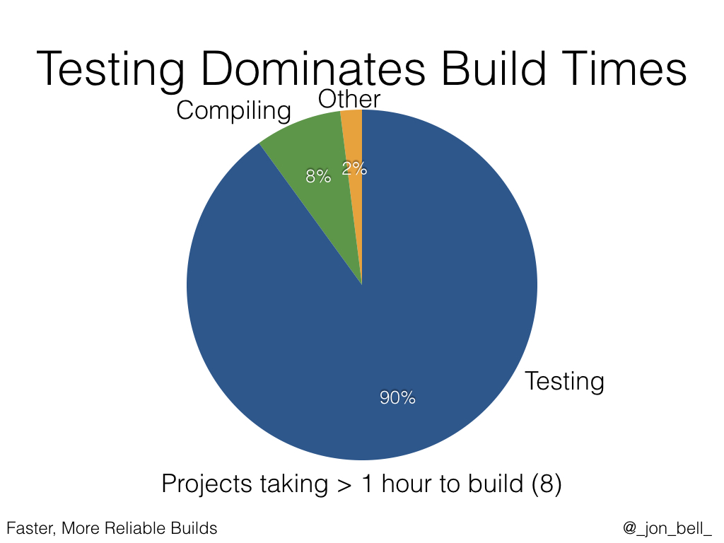
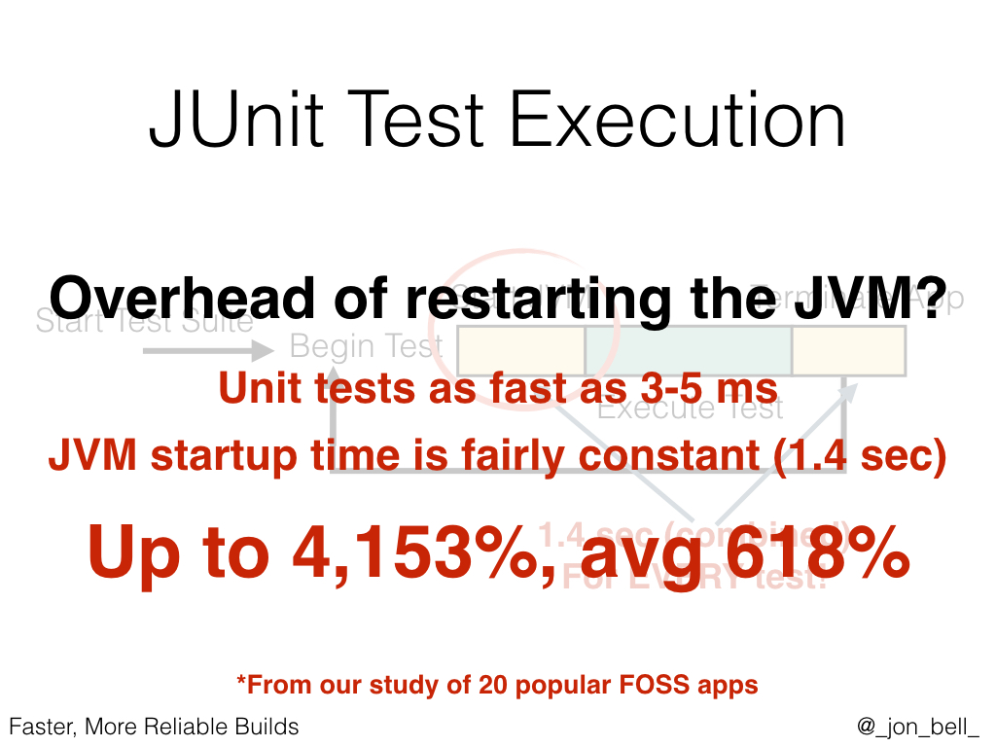
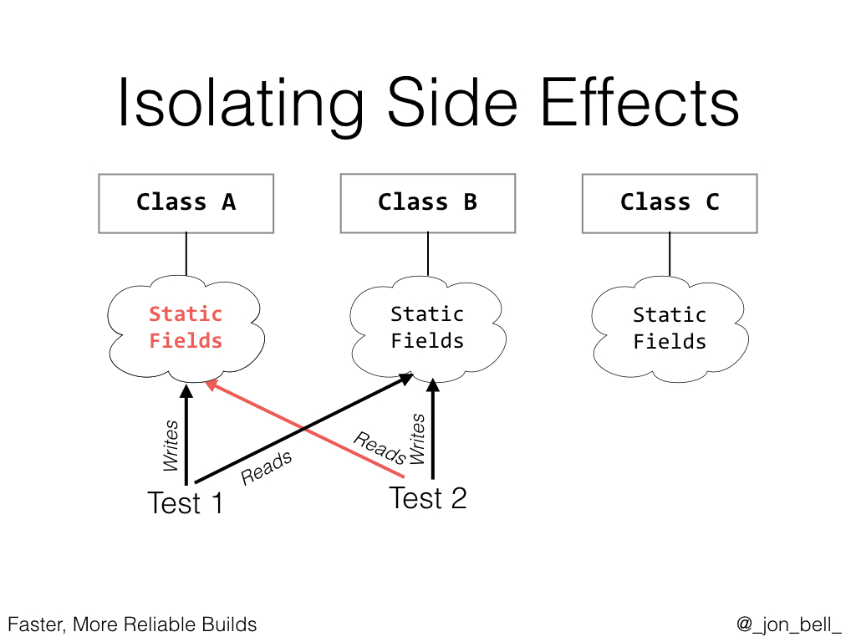
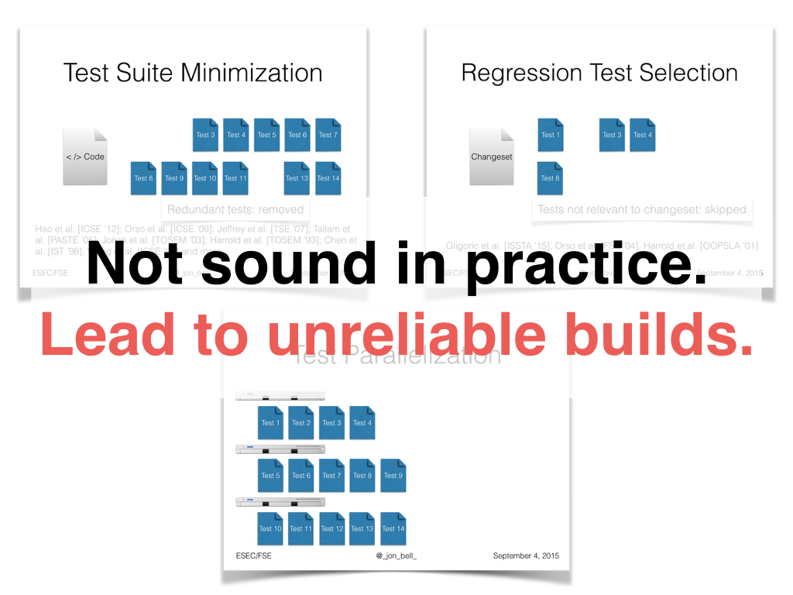
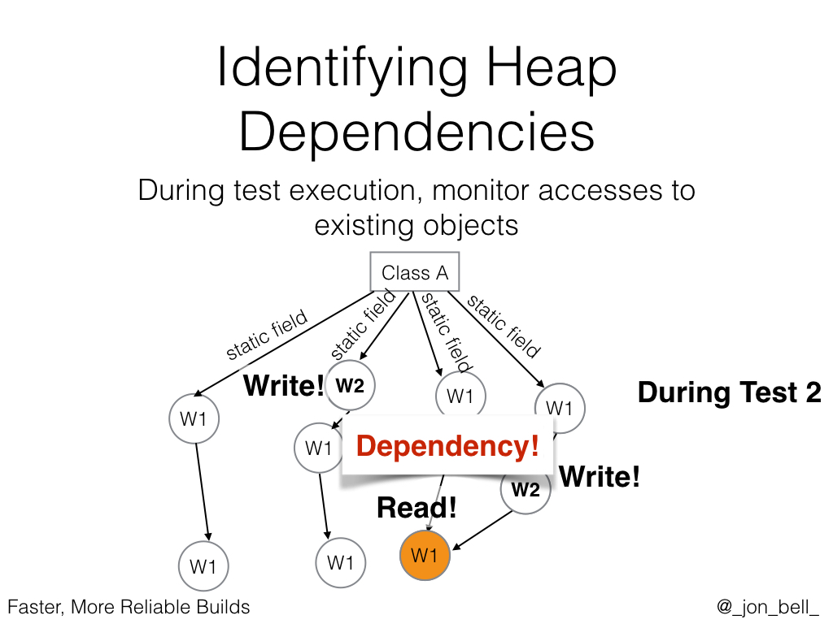
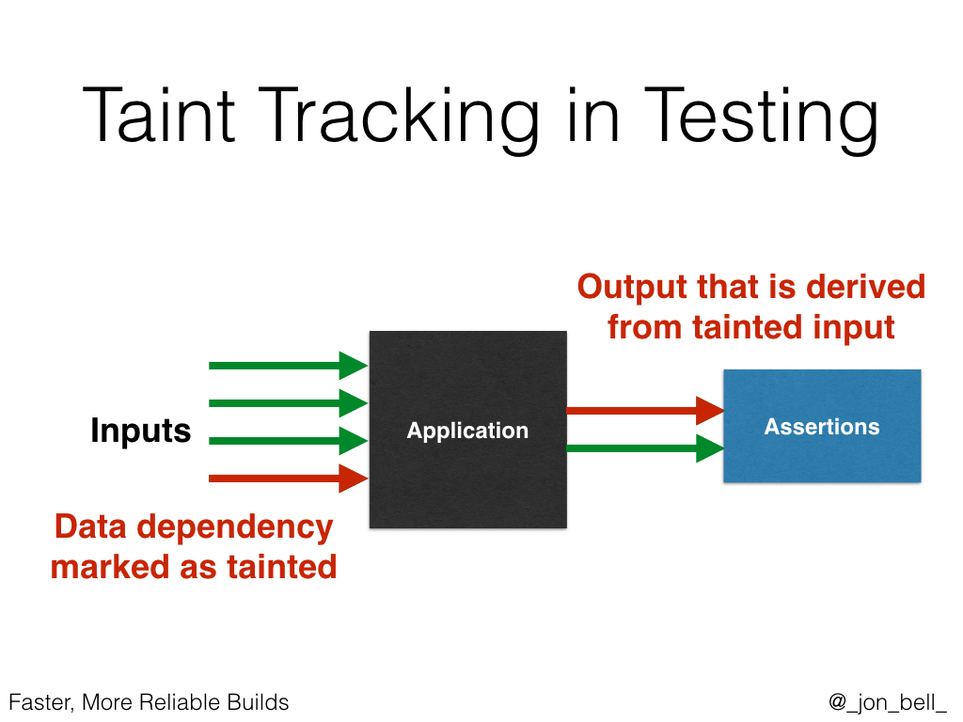
Faster, More Reliable Builds
Jonathan Bell
Columbia University
jbell@cs.columbia.edu
http://jonbell.net/
@_jon_bell_

Slide 77
Experiments
RQ1: How does VMVM compare to Test Suite Minimization?
RQ2: What are the performance gains of VMVM?
RQ3: Does VMVM impact fault finding ability?

Slide 78
RQ1: VMVM vs Test Minimization
Study design follows Zhang [ISSRE ‘11]’s evaluation of four minimization approaches
Compare to the minimization technique with least impact on fault finding ability, Harrold [TOSEM ‘93]'s technique
Study performed on the popular Software Infrastructure Repository dataset

Slide 79
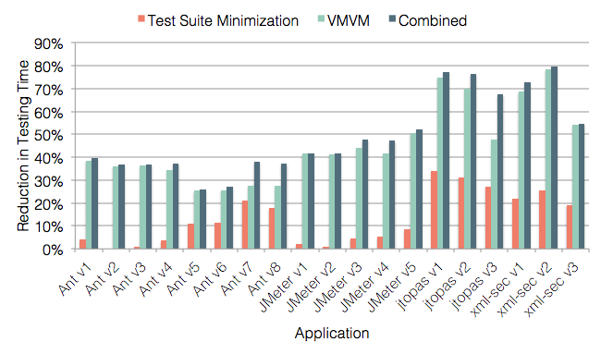
RQ1: VMVM vs Test Minimization
Larger is better
49%
46%
13%

Slide 80
Performance Evaluation
Previous study: well-studied suite of 4 projects, which average 37,000 LoC and 51 test classes
This study: manually collected repository of 20 projects, average 475,000 LoC and 56 test classes
Range from 5,000 LoC - 5,692,450 LoC; 3 - 292 test classes; 3.5-15 years in age

Slide 81
Performance Evaluation
Average: 62%
Max: 97%
Larger is better
Notes:
We show here the relative speedup afforded by VMVM in comparison to a “traditionally isolated” test suite execution, with each test running in the same JVM.

Slide 82
Factors that impact reduction
Looked for relationships between number of tests, lines of code, age of project, total testing time, time per test, and VMVM’s speedup
Result: Only average time per test is correlated with VMVM’s speedup (in fact, quite strongly; p < 0.0001)

Slide 83
RQ3: Impact on Fault Finding
No impact on fault finding from seeded faults (SIR)
Does VMVM correctly isolate tests though?
Compared false positives and negatives between un-isolated execution, traditionally isolated execution, and VMVM-isolated execution for these 20 complex applications
Result: False positives occur when not isolated. VMVM shows no false positives or false negatives.

Slide 84
Faster, More Reliable Builds
Jonathan Bell
Columbia University
jbell@cs.columbia.edu
http://jonbell.net/
@_jon_bell_

Slide 85
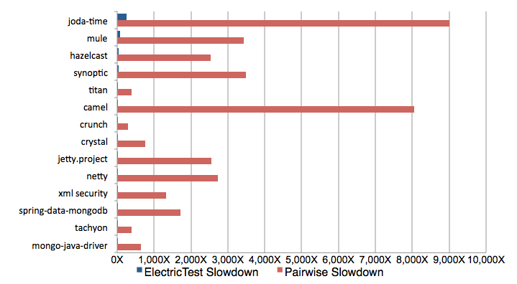

RQ2: Overhead
*418,000X
On average, ElectricTest is 885X faster than running all tests pairwise
Slowdown relative to a single test suite execution (lower is better)
Notes:
We show here the comparison between ElectricTest and DTDetector’s pairwise brute-force test dependency detection. On average, ElectricTest is 215 times faster, and is guaranteed to find all dependencies, unlike the pairwise approach.

Slide 86
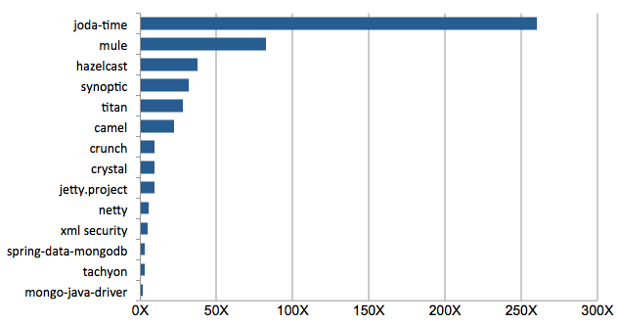
RQ2: Overhead
A lot of fast running tests:
Runtime dominated by pauses
between tests (gc)
Average 36X
Slowdown relative to a single test suite execution (lower is better)
Notes:
To zoom in and look specifically at the performance of ElectricTest on these projects, we found that in the cases where ElectricTest was slower, the slowdown was almost always directly related to the speed and number of tests: suites that had a lot of very fast running tests like joda-time were penalized by the time cost of performing a garbage collection and heap walk at the end of each test run. However, we have some compelling preliminary evidence that shows that dependent tests always start their life as such - it is sufficient to perform this analysis only when tests are added - and not when tests or code are changed.

Slide 87
Electric Test Detects Extra Dependencies
 | Dependencies Detected |  |  |  | ElectricTest Shared
 | Ground Truth | ElectricTest |  |  | Resource Locations
Project |  | Writers | Readers |  | App | Library
Joda | 2 | 15 | 121 |  | 39 | 12
XMLSecurity | 4 | 3 | 103 |  | 3 | 15
Crystal | 18 | 15 | 39 |  | 4 | 19
Synoptic | 1 | 10 | 117 |  | 3 | 14
Notes:
ElectricTest

Slide 88
Understanding Dependencies
What should a developer do about test dependencies?
Might be intentional (e.g. cache shared state)
Might be unintentional but OK (e.g. loggers)
Might be unintentional and bad (e.g. bug)
Notes:
While ElectricTest can be used to automatically enable sound test acceleration, we also envision it can be used to help developers understand the dependencies between their tests, some of which might be indicative of bugs. For instance, some dependencies…

Slide 89

Assisting Debugging
Test 3
Test 1
Depends on
Debugging information reported by the previous technique

Slide 90




Assisting Debugging
Value that is read
Test that wrote value
Exception in thread "main" edu.columbia.cs.psl.testdepends.DependencyException: Static Field ClassA.FieldA member was previously written by Test 1, read here.
at edu.columbia.cs.psl.testdepends.test.Example$NestedExample.dragons(Example.java:20)
at edu.columbia.cs.psl.testdepends.test.Example.moreMagic(Example.java:12)
at edu.columbia.cs.psl.testdepends.test.Example.magic(Example.java:8)
at edu.columbia.cs.psl.testdepends.test.Example.main(Example.java:15)
Stack trace shows use
Really helpful
Notes:
ElectricTest can also help developers understand the dependencies that exist between their tests. An exception can be thrown at the point of each data dependency (or simply logged) that shows exactly how the dependency occurred, noting the value read, and a complete stack trace at that site

